Slide 1
Teaching Session | Decision Trees
Tamojit Maiti Masters in Applied Statistics and Operations Research, ISI Kolkata Data Scientist at Sixt R&D, previously at Rapido & AB InBev

Slide 2
Agenda
Introduction
What
Why
Collaborative Filtering
Theory
User-User
Item-Item
Drawbacks
Latent Factor Model
Theory
Drawbacks
Content Based Filtering
Theory
Caveats
Tamojit Maiti 8th October 2022

Slide 3
Introduction to Decision Trees
Tamojit Maiti 8th October 2022

Slide 4
What
Decision tree is a type of supervised learning algorithm that is used in classification or regression problems
It works for both categorical and continuous input and output variables
An example of non-parametric model, the number of parameters can be flexible
Usually more interpretable for people from non-tech backgrounds
It closesly mimics the human decision making process for simple tasks
Tamojit Maiti 8th October 2022

Slide 5
Example
Let’s say we have a sample of 30 students with three variables Gender (Boy/Girl), Class(IX/X) and Height (5 to 6 ft). 15 out of these 30 play cricket in leisure time. Now, I want to create a model to predict who will play cricket during leisure period?
In this problem, we need to segregate students who play cricket in their leisure time based on highly significant input variable among all three
This is where decision tree helps, it will segregate the students based on all values of three variable and identify the variable, which creates the best homogeneous sets of students
Tamojit Maiti 8th October 2022

Slide 6
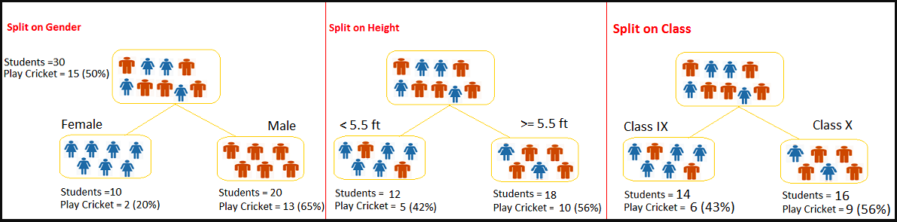
Choosing Variables to Split
The decision tree identifies the most significant variable and its value that gives best homogeneous sets of population.
Now the question is, how does it identify the variable and the split?
Tamojit Maiti 9th October 2022

Slide 7
How to split?
The decision of making strategic splits heavily affects a tree’s accuracy. The decision criteria is different for classification and regression trees.
Decision trees use multiple algorithms to decide to split a node in two or more sub-nodes.
Decision tree splits the nodes on all available variables and then selects the split which results in most homogeneous sub-nodes.
Methods to determine best split:
Information Gain
Gini
Chi Square
Reduction in Variance
Tamojit Maiti 9th October 2022

Slide 8
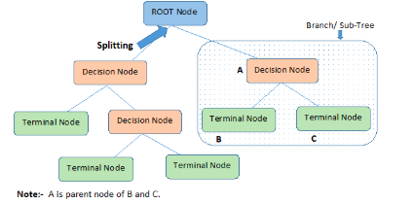
Important Terminology
Root Node: It represents entire population or sample andthis further gets divided into two sets.
Splitting: It is a process of dividing a node into two sub - nodes.
Leaf/ Terminal Node: Nodes do not split is called leaf or terminal node
Pruning: When we remove sub-nodes of a decision node
Tamojit Maiti 9th October 2022

Slide 9
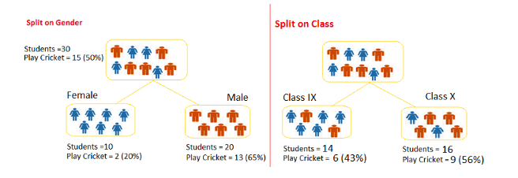
Example (…continued)
Referring to earlier example used, where we want to segregate the students based on target variable (playing cricket or not). In the snapshot below, we split the population using two input variables Gender and Class. Now, I want to identify which split is producing more homogeneous sub-nodes using Information Gain
.
Tamojit Maiti 9th October 2022

Slide 10
Advantages and Disadvantages of Decision Tree
Advantages
Easy to Understand
Useful in Data exploration
Non Parametric Method
Disadvantages
Over fitting
Tamojit Maiti 9th October 2022

